Slide 1
Auto Playing Flappy Bird
Name:Pranjal Pandey
Roll No:635

Slide 2
Introduction
AI Learns to play the classic Flappy Bird Game using the Genetic Algorithm and Neuro evolution.
A genetic algorithm is a search heuristic that is inspired by Charles Darwin’s theory of natural evolution. This algorithm reflects the process of natural selection where the fittest individuals are selected for reproduction in order to produce offspring of the next generation.

Slide 3
Introduction
Using the same genetic algorithm and Reinforcement learning, train the AI(bird) to automatically jump over the pipes and obtain as much score as possible.

Slide 4

UI Design (currently)

Slide 5



Slide 6
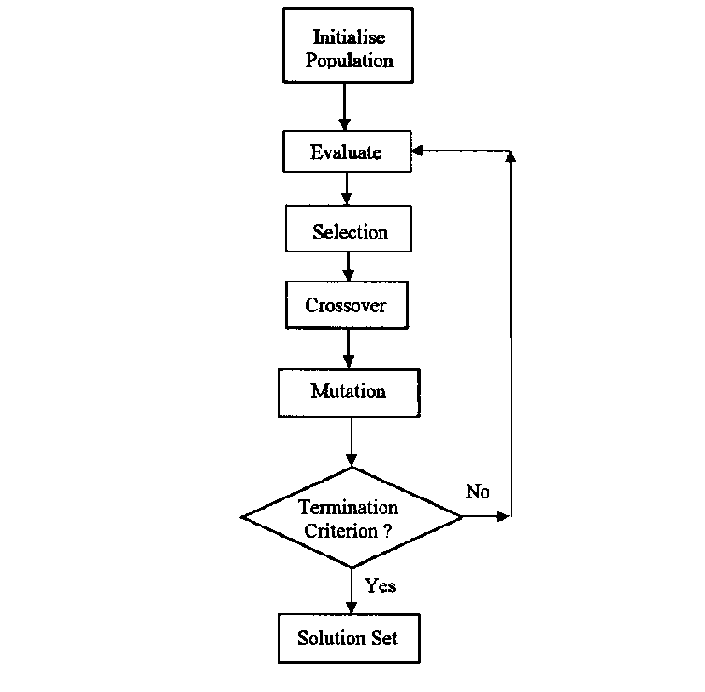
System Architecture and Design

Slide 7
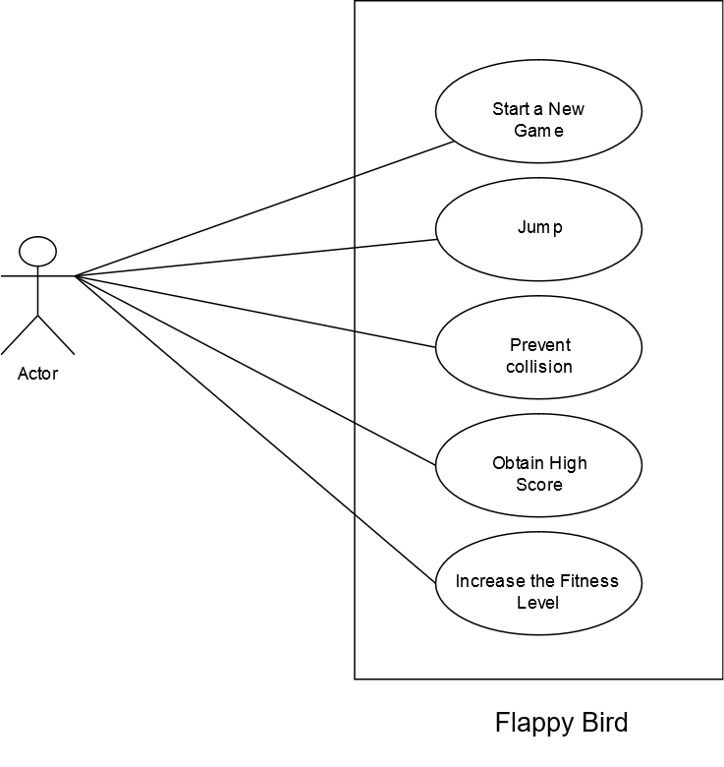
Use Case Diagram

Slide 8
Status of the project
General Layout to train the bird is completed.
Fitness level of individual bird is tracked.
Random generation of the pipes and birds is completed.
Yet to select the birds with best fitness and reproduce them.
Yet to perform Crossover and Mutation.
Yet to work on making the visuals pleasing and store the high score.

Slide 9
Challenges
Track the fitness level of individual birds and modify(mutate) them to form a new population.
The solutions from one population are taken and used to form new population. Each new population(generation) is motivated by a hope that the new population will be better than the old.

Slide 10
Limitations
Requires many generation to obtain a fit population, hence time consuming.
Cannot predict the exact fitness of the bird at any given time.

Slide 11
Any Queries?
Thank You

